Slide 1


Artificial Intelligence
Machine Learning,
Data Science
Artificial Neural Networks
Acknowledgements: Coursera, various references from web

Slide 2


Binary Classification
size
Price of the House
Zip code
price
price
#bedrooms
Size of the house

Slide 3
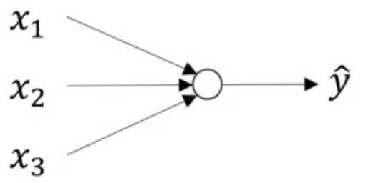
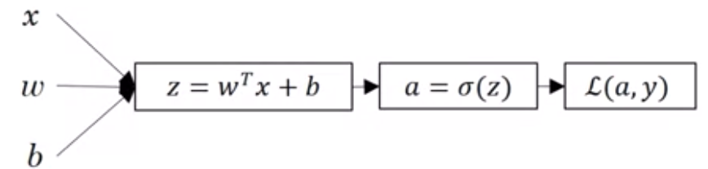
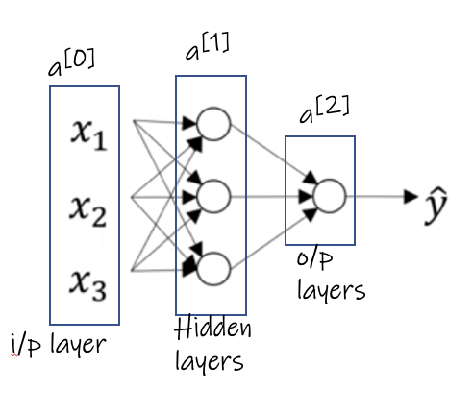
Logistic Regression and Neural Networks

Slide 4
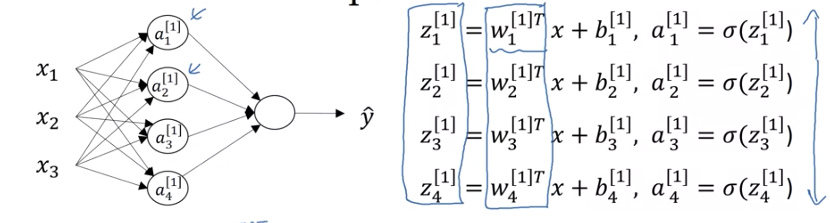
Computing Weights

Slide 5
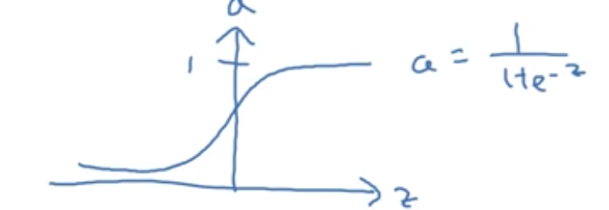
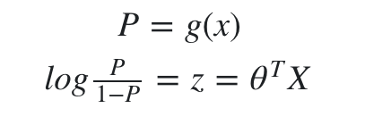
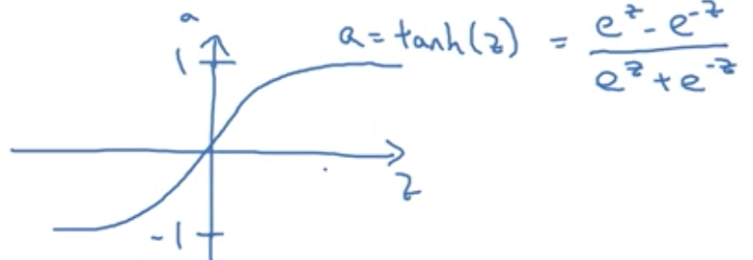
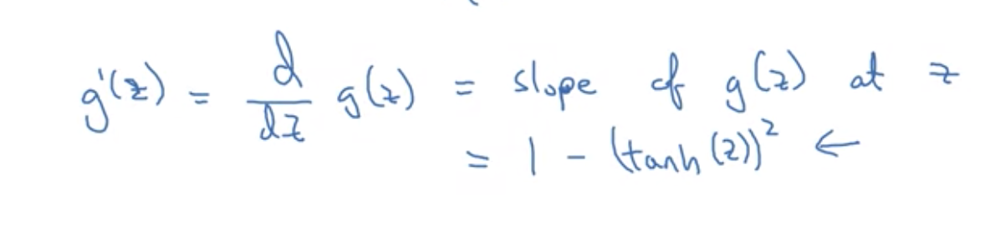
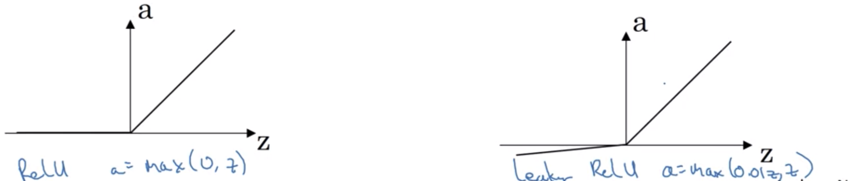
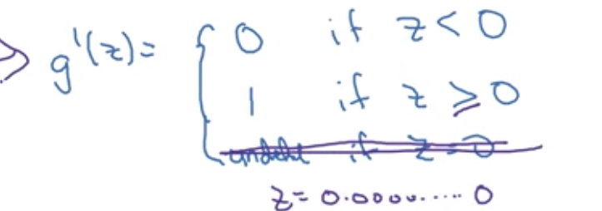
Activation Functions
What is a logit function?

Slide 6
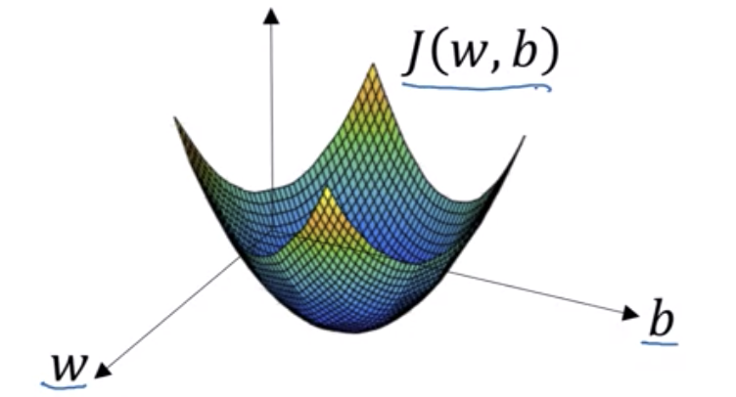
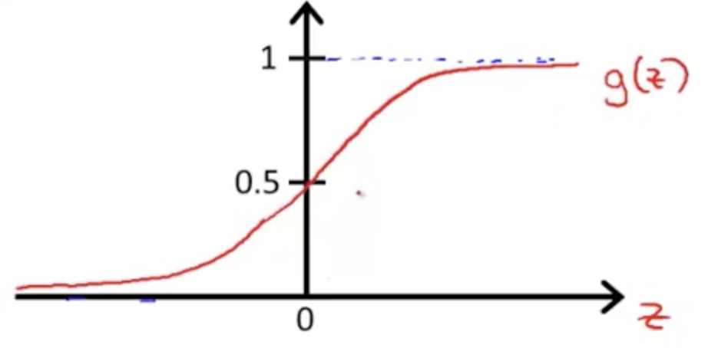
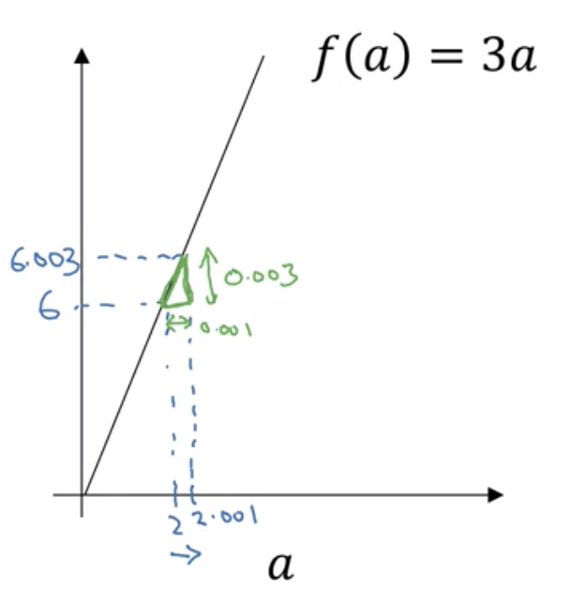

Slide 7
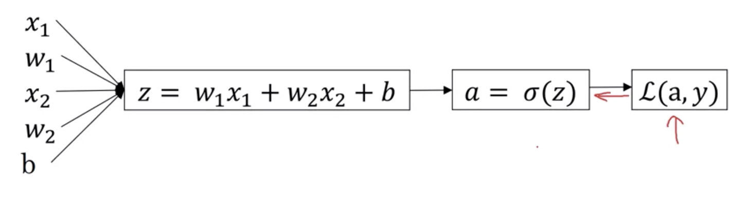
u = b c
v = a + u
J = 3 v

Slide 8
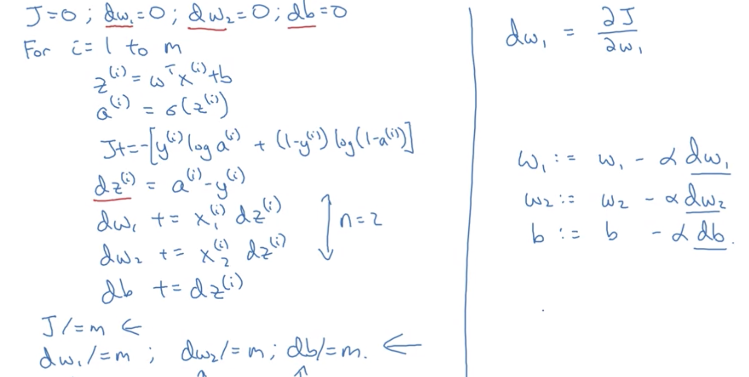
Gradient Descent with Adjust weights

Slide 9
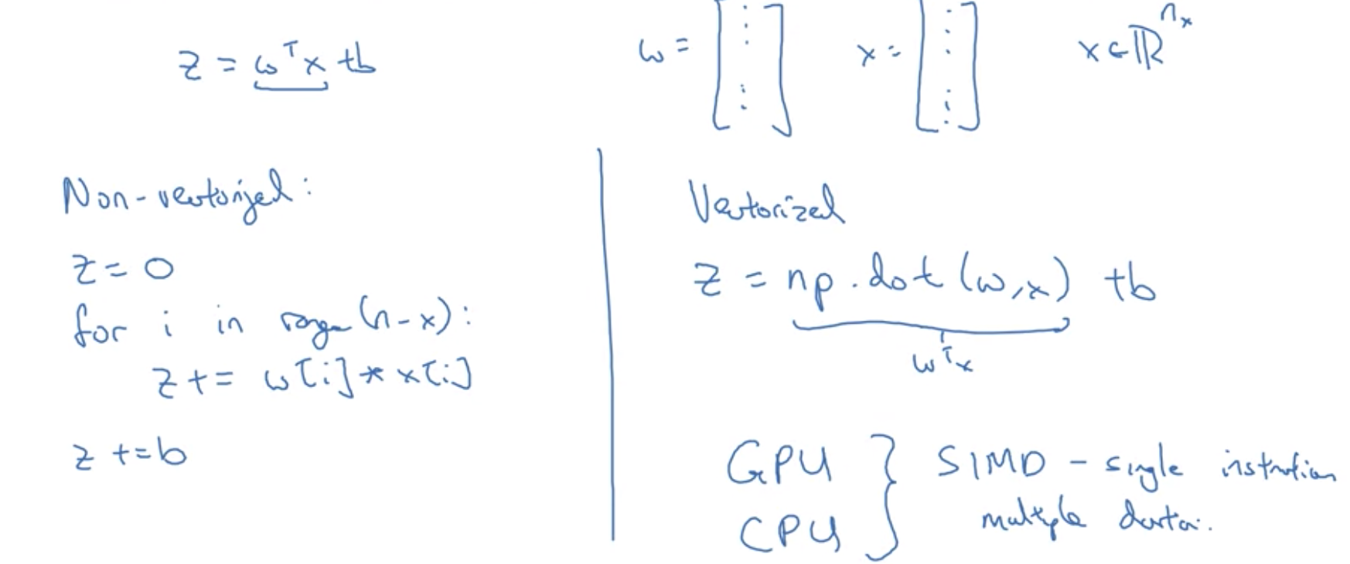
Vectorization

Slide 10
Sequence Models
Recurrent Neural network

Slide 11
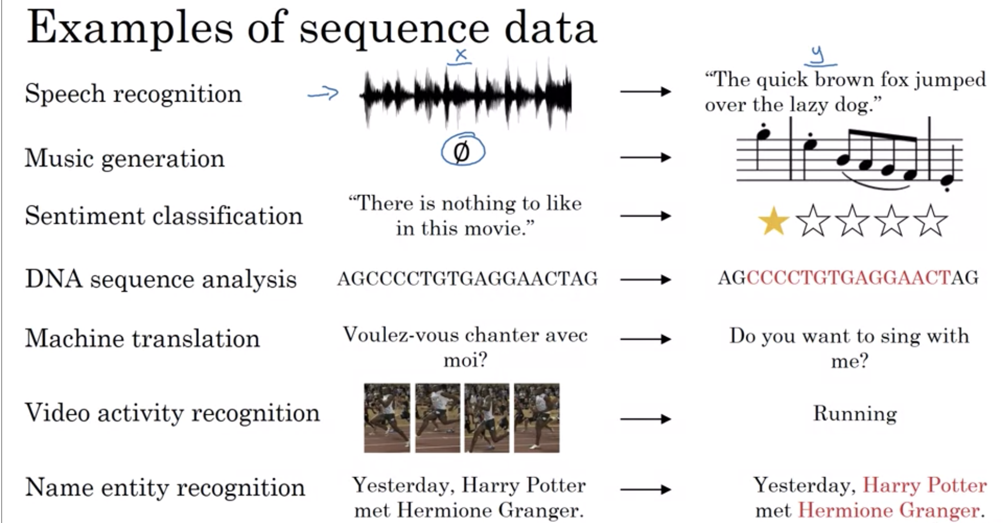
Sequence Models Example
Sequence Models
Many – Many
1 – Many
Many – 1
1 – 1
Additional references on Introduction to Deep Learning: https://www.youtube.com/watch?v=5tvmMX8r_OM&list=PLtBw6njQRU-rwp5__7C0oIVt26ZgjG9NI

Slide 12
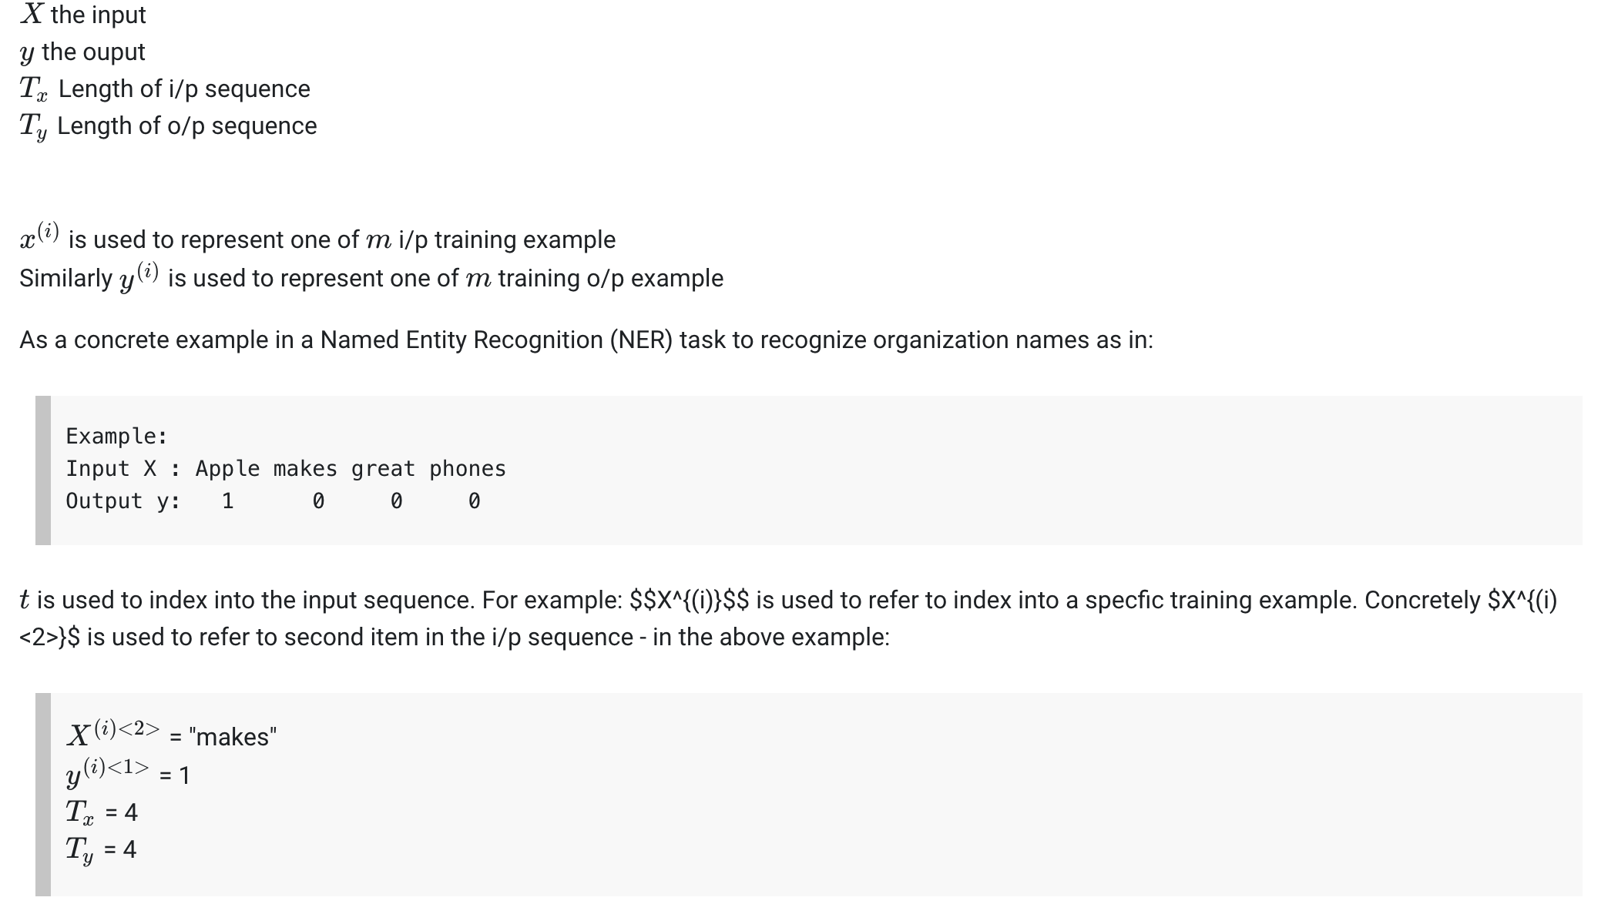
Notations
x^{(i)<t>} : input at time t T_{x} : Length of input sequence
y^{(i)<t>} : input at time t T_{y} : Length of input sequence

Slide 13
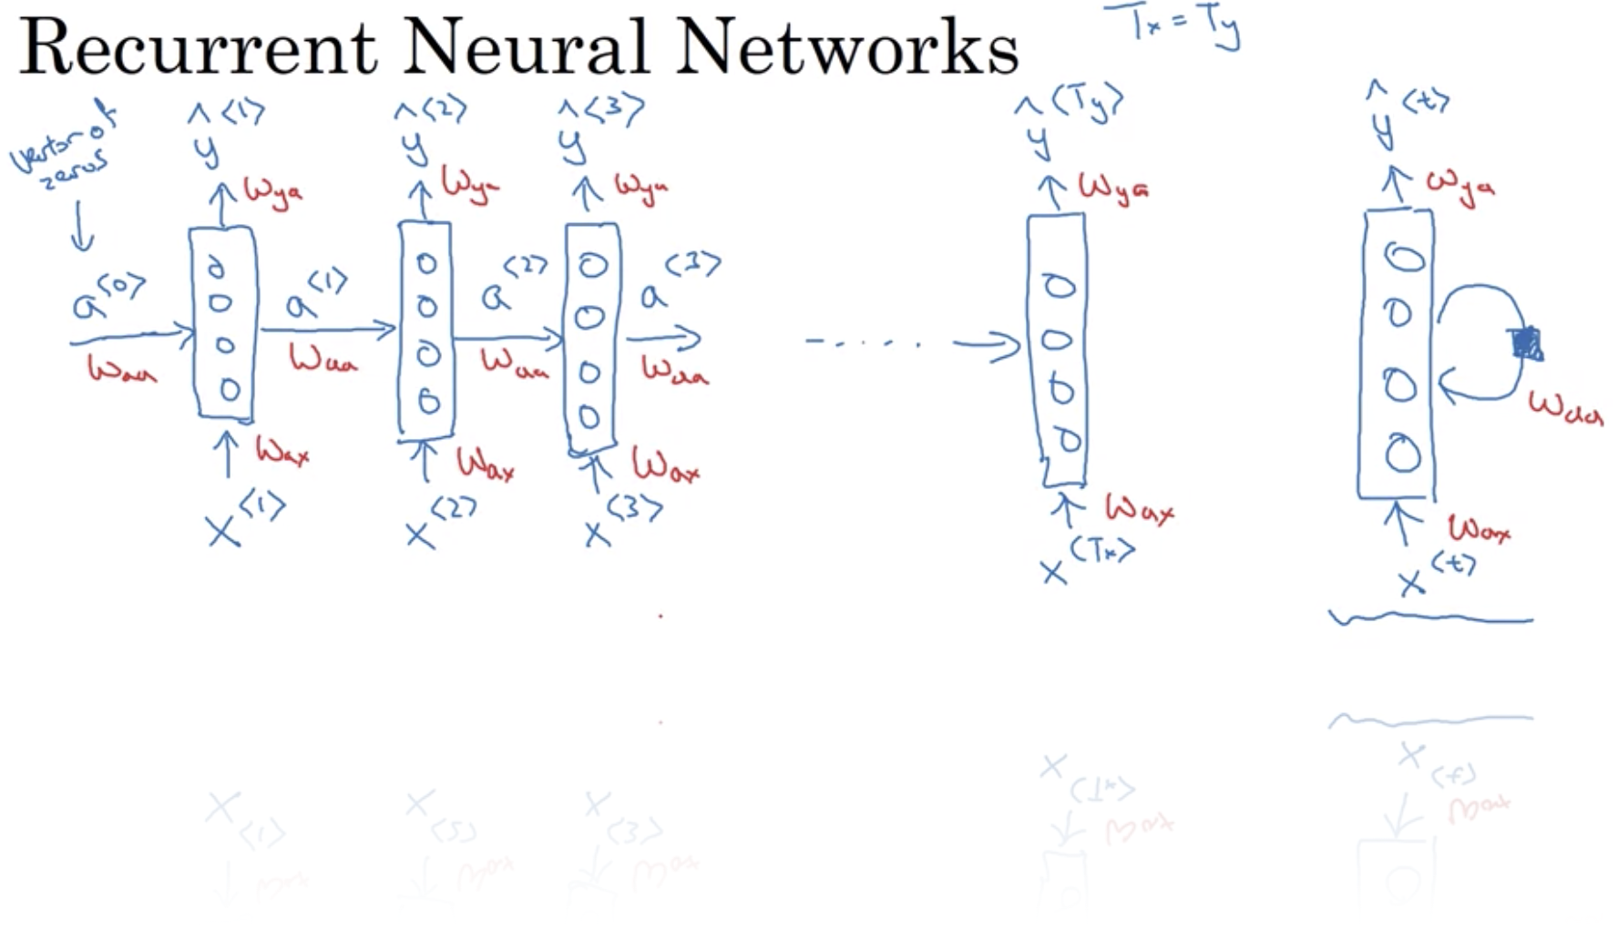
Notations
x^{(i)<t>} : input at time t T_{x} : Length of input sequence
y^{(i)<t>} : input at time t T_{y} : Length of input sequence

Slide 14
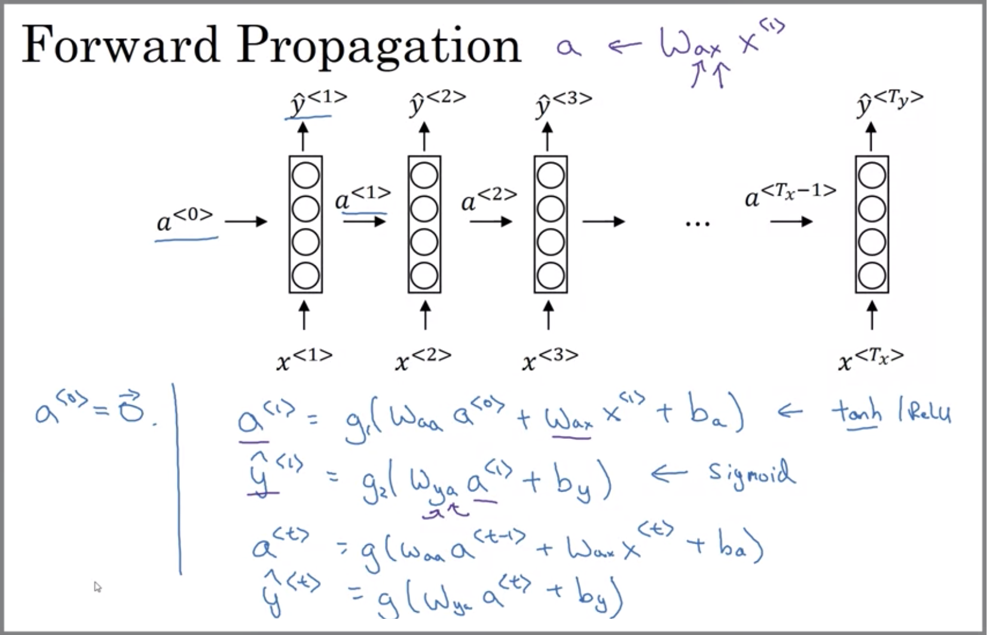
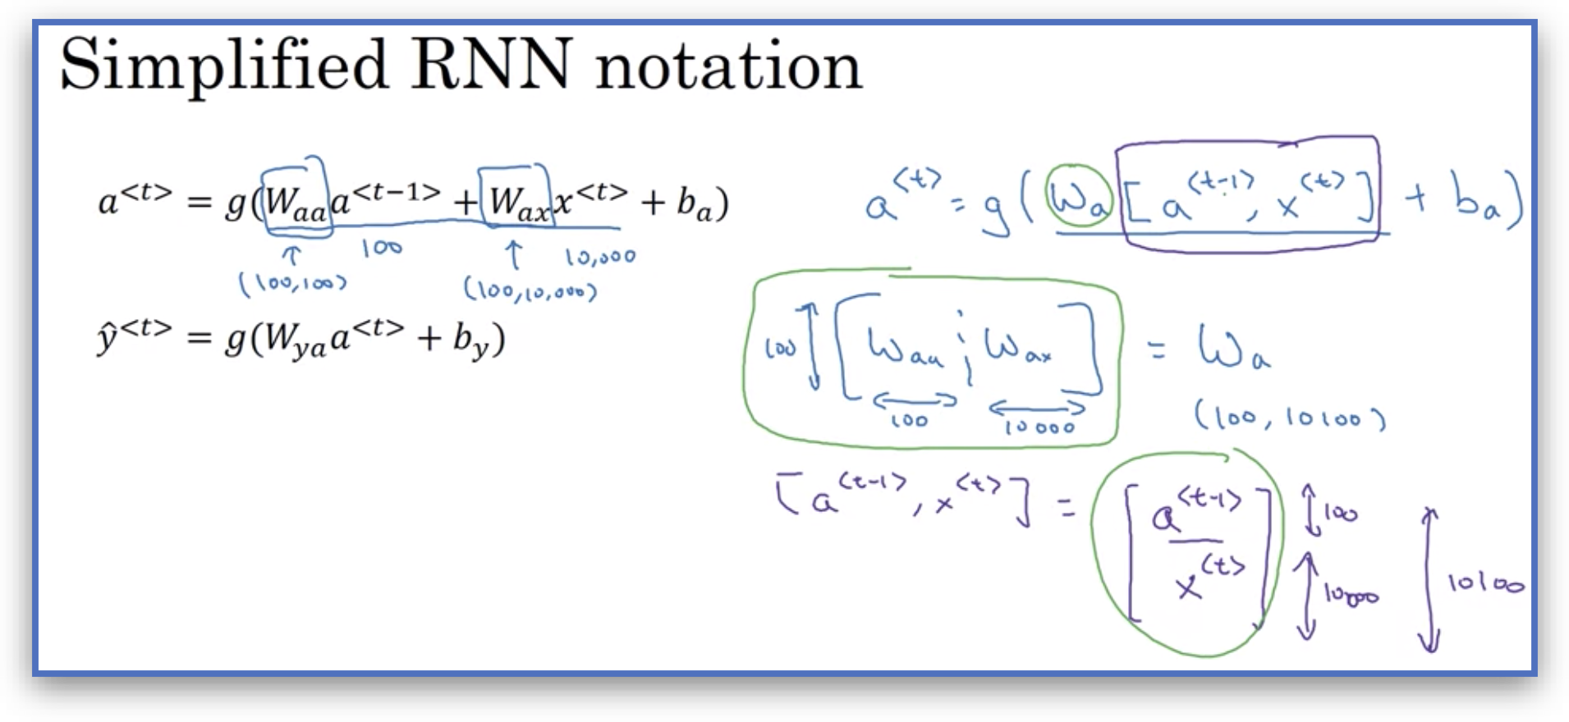
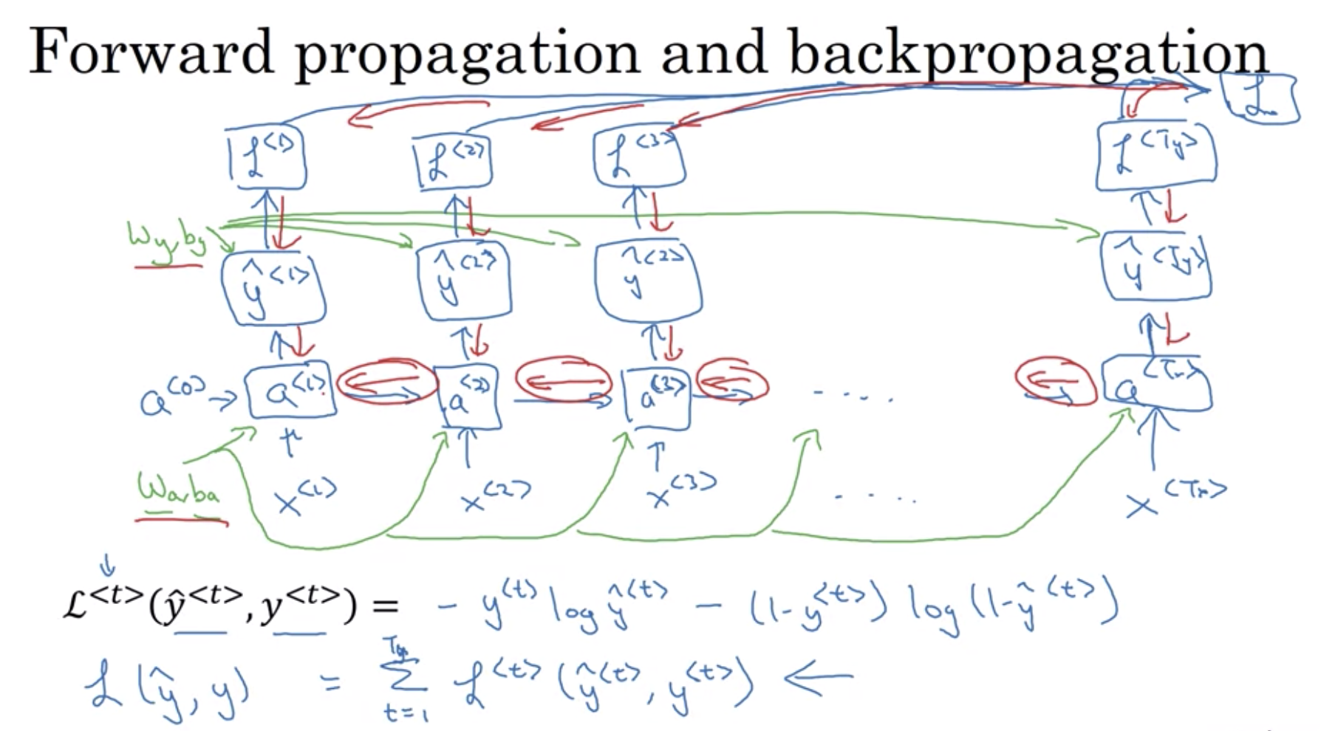
Calculations

Slide 15
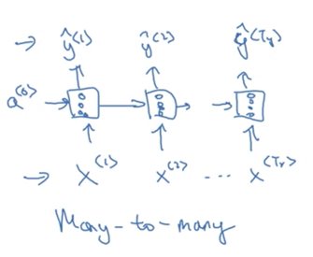
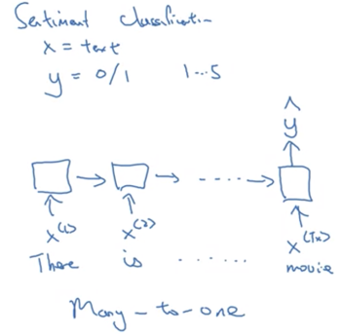
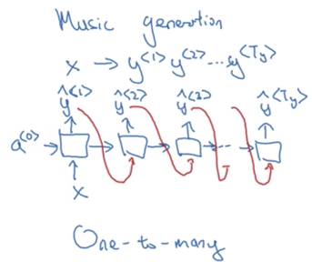
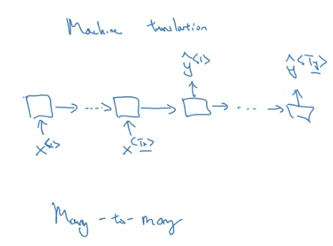
Different type of Architecture
Many to Many | Many to 1 | 1 to many | 1 to 1
Tx,Ty can be different Ex: translation | Sentiment classification | Music Generation | Becomes generic simple NN

Slide 16
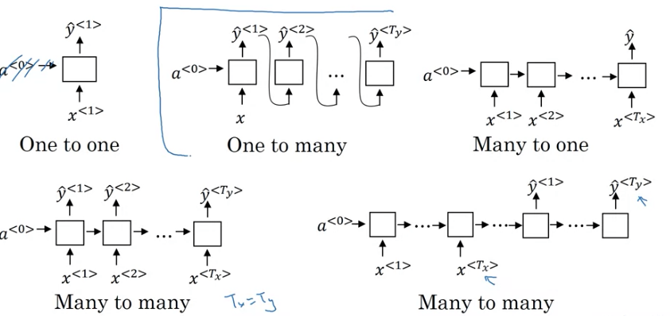
Different type of Architecture

Slide 17
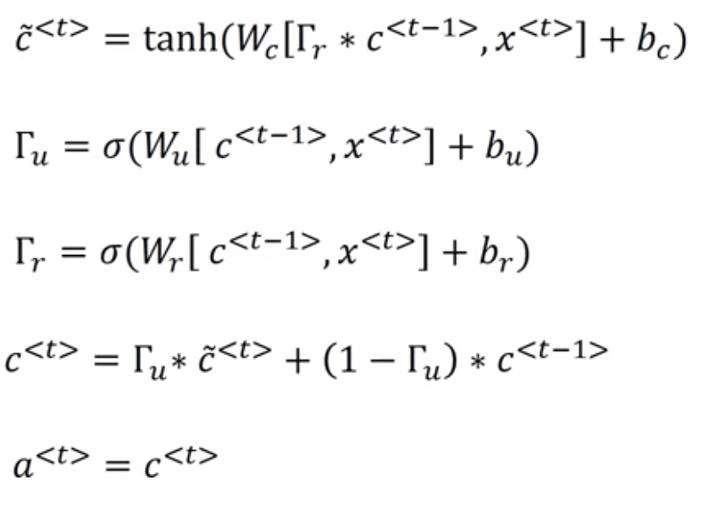
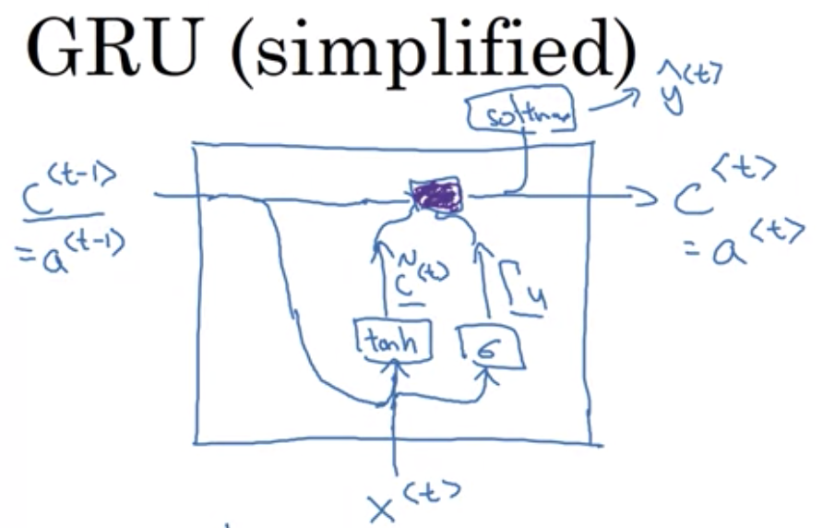
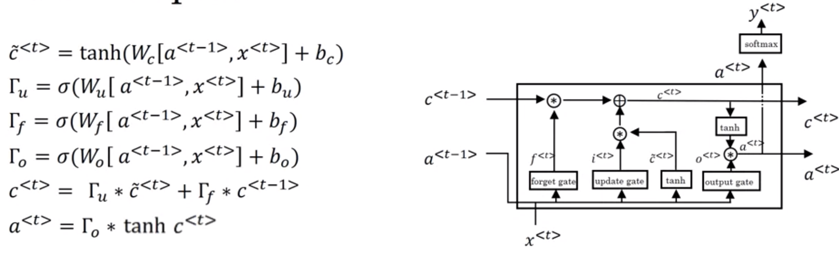
GRU

Slide 18
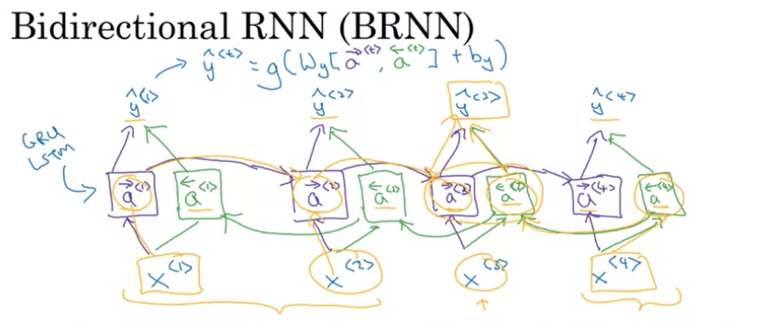
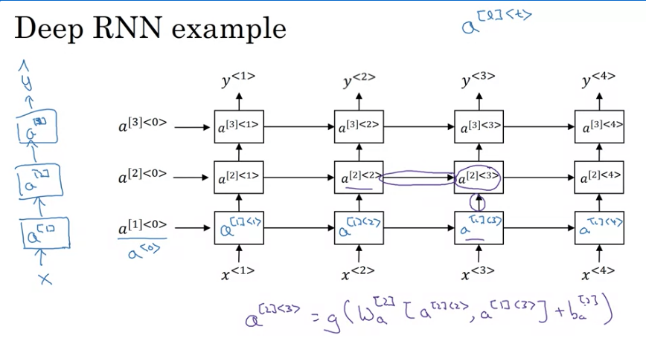
Bidirectional RNN – Deep RNN
Disadvantages:
You need entire datasets
Advantage:
Take information about the future
Used for post-mortem
Disadvantages:
Takes longer to train and complexity
Advantage:
Most times the layers are in 3

